Slide 1
REST Controllers and Routing
Controllers, Routes, Responses

Slide 2
Table of Contents
Controller
Routing
Request and Response
REST

Slide 3
Controller

Slide 4
Controller
Only concerned with Controlling
Not responsible for the doing
Takes care of web specific stuff like authentication, cookies, request variables, query string

Slide 5
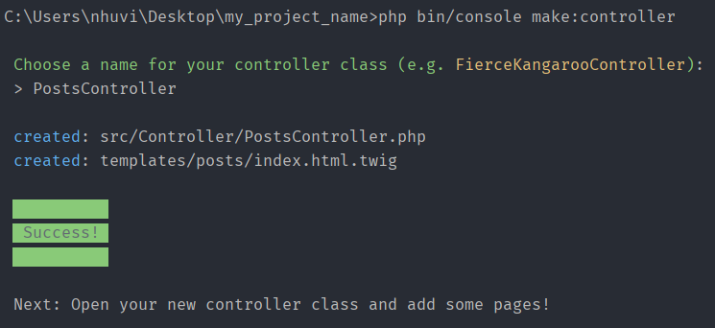
Controller
php bin/console make:controller

Slide 6
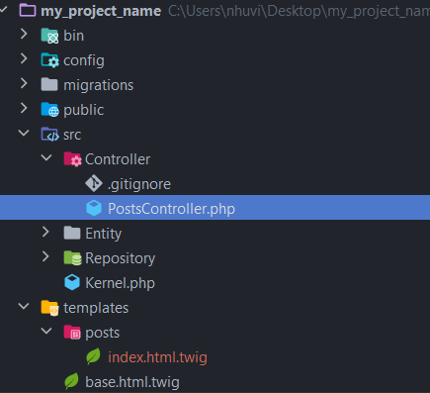
Controller
Location: src/Controller directory

Slide 7
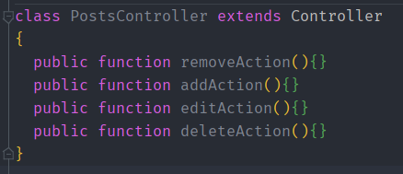
Controller
Controller names should end with "Controller"
Controller action names should end with "Action"

Slide 8

Controller
Must always return Response:
5-10-20 rule:
5 or less class variables
10 or less actions
20 or less lines of code for each action

Slide 9
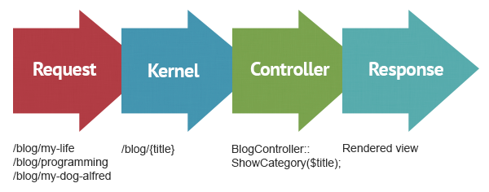
Controller
Requests, Controller, Response Lifecycle

Slide 10
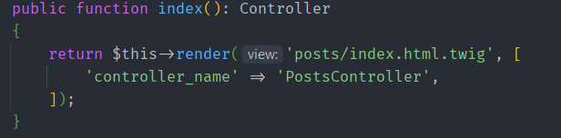
Controller
Symfony’s Base Controller
Provides access to helper methods and the service container
Won’t change your controller workflow

Slide 11
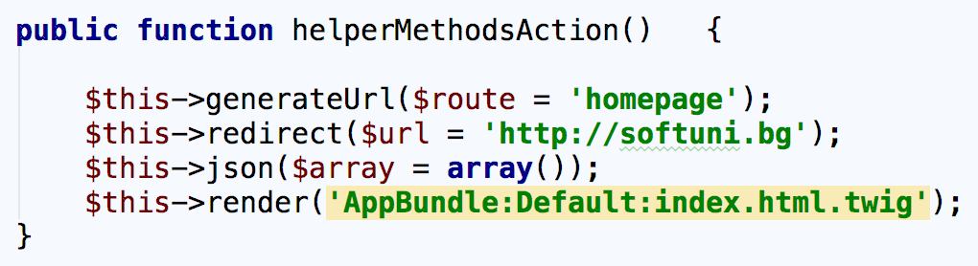
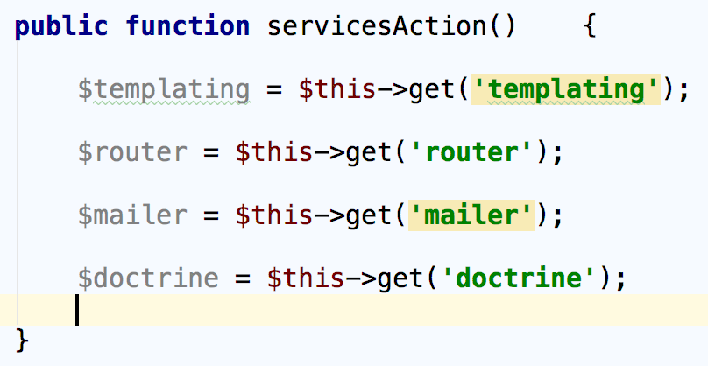
Controller
Symfony’s Base Controller - helper methods example
Symfony’s Base Controller - services example

Slide 12
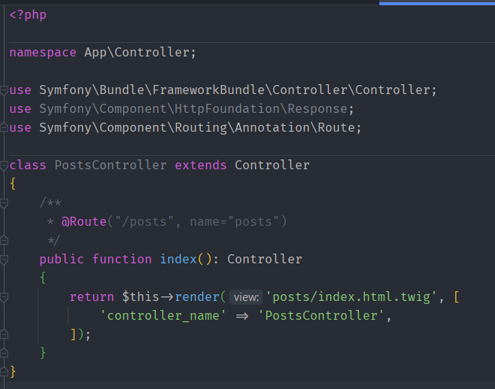
Controller
Example

Slide 13

Routing
Routes and Mapping to Controller

Slide 14
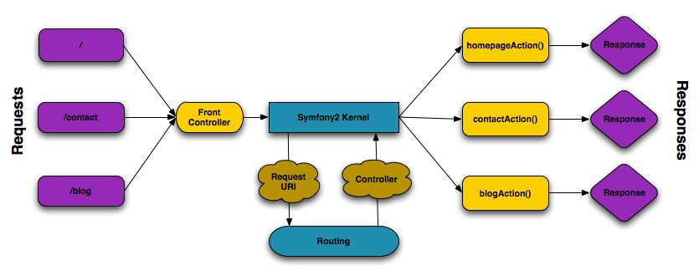

Routing
Process of breaking the URL into components and deciding what script to call

Slide 15
Routing
Four ways to define routes:
Annotations
YAML
XML
PHP
Only one type of configuration is allowed
No difference in execution time

Slide 16
Routing
Annotation: @Route

Slide 17
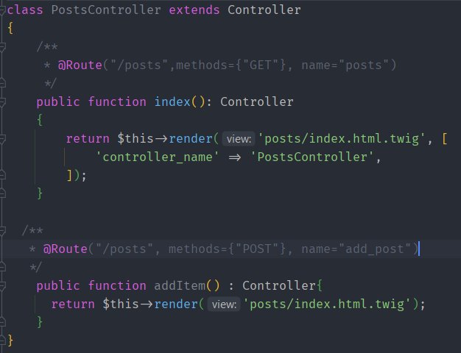
Routing
Configure different HTTP methods for the route
Annotation: @Method

Slide 18
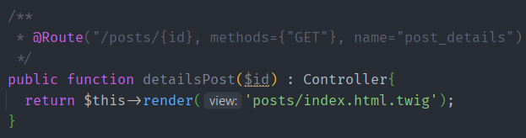

Routing
Route Parameters
Annotation

Slide 19
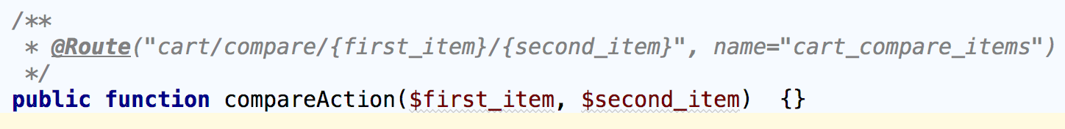
Routing
Route Parameters
Additional parameters are converted to query parameters
Parameters names passed to the controller must match route parameters names
Parameters and route parameters names must be the same

Slide 20
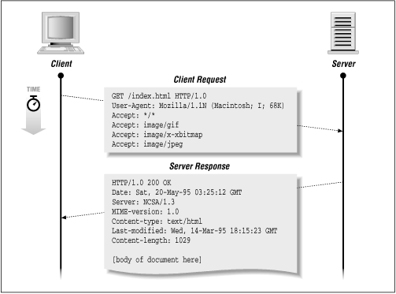
Request & Response

Slide 21
Request & Response
Symfony Application Lifecycle

Slide 22
Request & Response
Symfony Application Lifecycle
Client sends an HTTP Request
For each request the front controller is executed Index file (app.php or app_dev.php)
Router component matches the request and execute controller
Response object is returned

Slide 23
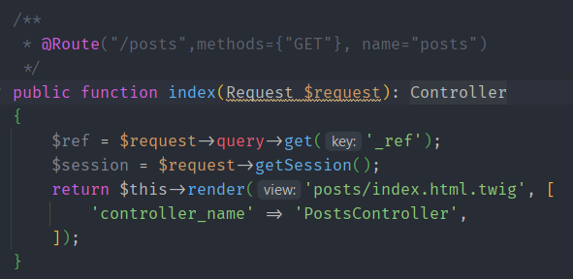
Request & Response
Request
To use it in your controller type-hint it with the Request class
Import the Request Object in controller class

Slide 24
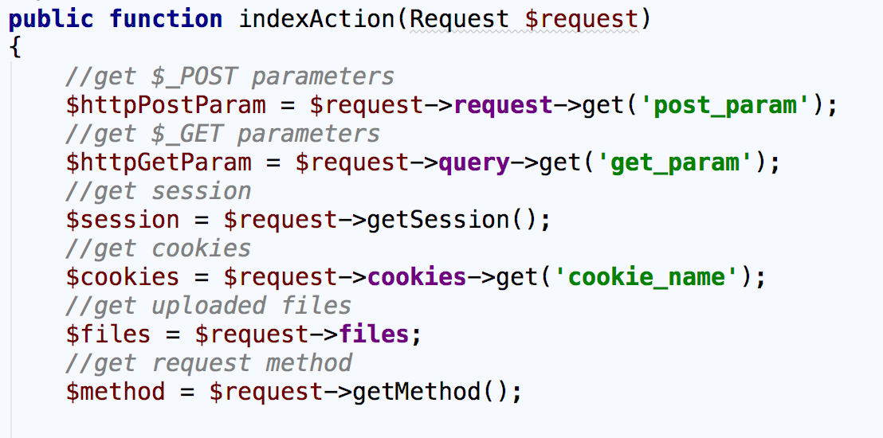
Request & Response
Request Examples:

Slide 25
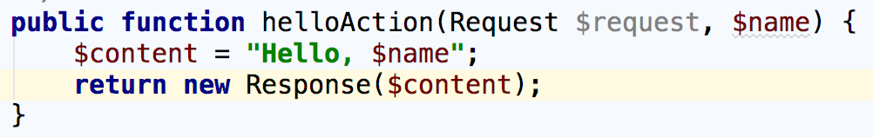
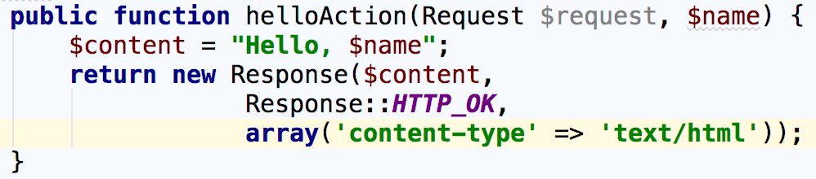
Request & Response
Response
Import the Response Object in controller class

Slide 26
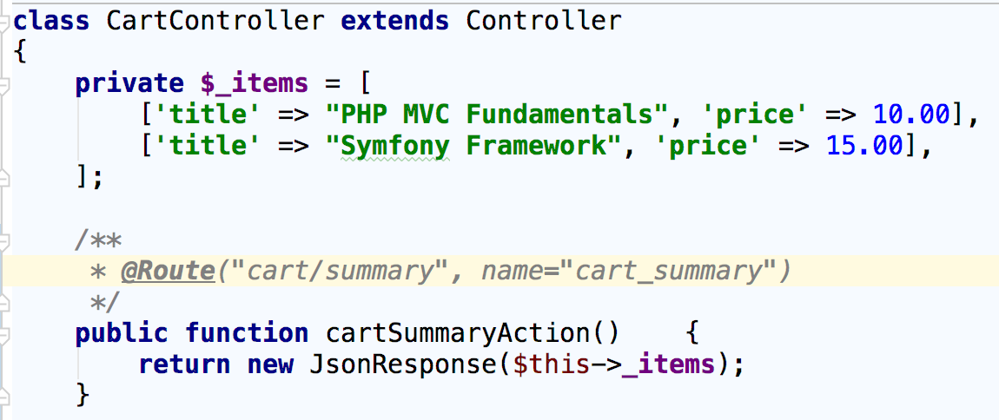
Request & Response
JsonResponse

Slide 27
Request & Response
Response Content-Types
json - application/json
xml - application/xml
png image - image/png
html - text/html
full list of content types: developer.mozilla.org

Slide 28
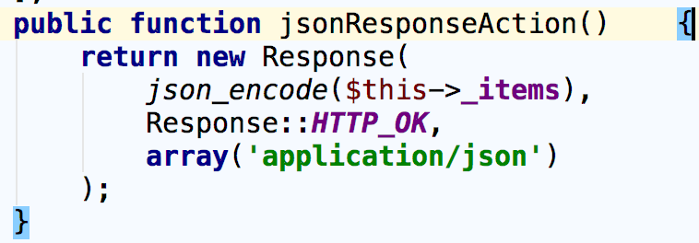
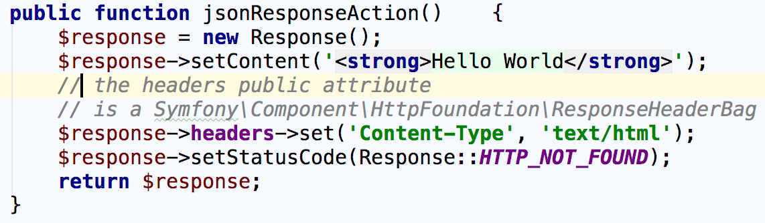
Request & Response
Set Conten-type Examples
Set Content-type Examples

Slide 29
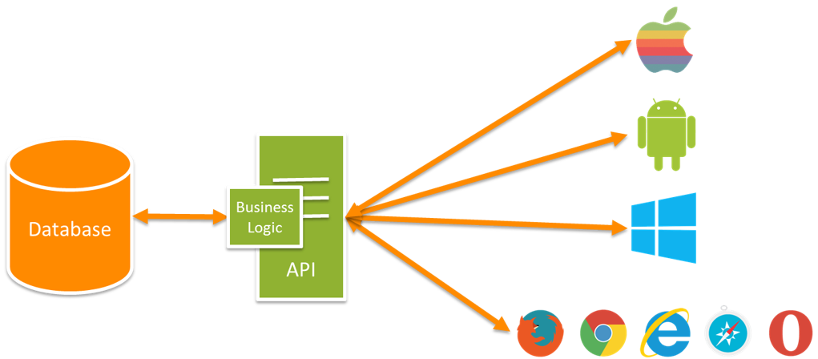
REST
What is REST?
REpresentational State Transfer
Interface from one program to another
REST is stateless
REST is resource based

Slide 30
REST & HTTP
Request methods:
GET - Get resource
POST - Create resource
PUT - Update resource
PATCH - Partly update resource
DELETE - Delete resource
HEAD - Get headers for resource
Response: json, xml

Slide 31
Summary
Controllers – Create controllers, actions, 5-10-20 rule
Routing – Define routes, configuration, route parameters
Request & Response – Request methods, Response types
REST – Rest concepts, REST URIs, Responses

